Slide 1
Discovery Assessment
A Guide to Data Reports

Slide 2
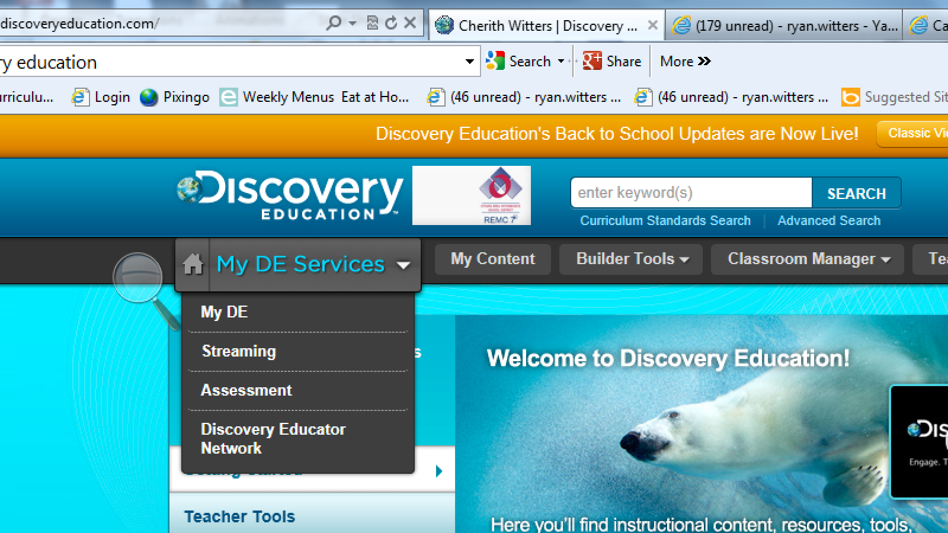
Where do I begin?
Click Here

Slide 3
Now what?
Click Here

Slide 4
This is where you can find your reports.
Begins with a whole class score. “Drill down” further by clicking on the blue links. It will eventually go to a student breakdown of specific skill areas.
Allows you to see student answers, questions right/wrong, test questions, discovery online supplements, etc.
Allows you to see a composite report on individual students.
Great report to compare student growth (can be viewed once another test is taken)
Will provide you with 5 visual reports per subject:
Class Summary
Student Skill Report
Student Subskill Report
Answers Report
Item Report

Slide 5
Guide to Specific Reports
Click here until directions appear here.
Now choose a report to view by clicking on it!
Drill Down
Interactive Item Summary
PDF Individual Student
Keep clicking until this button spins, then use it to navigate back to this menu!
PDF Teacher
FINISHED

Slide 6
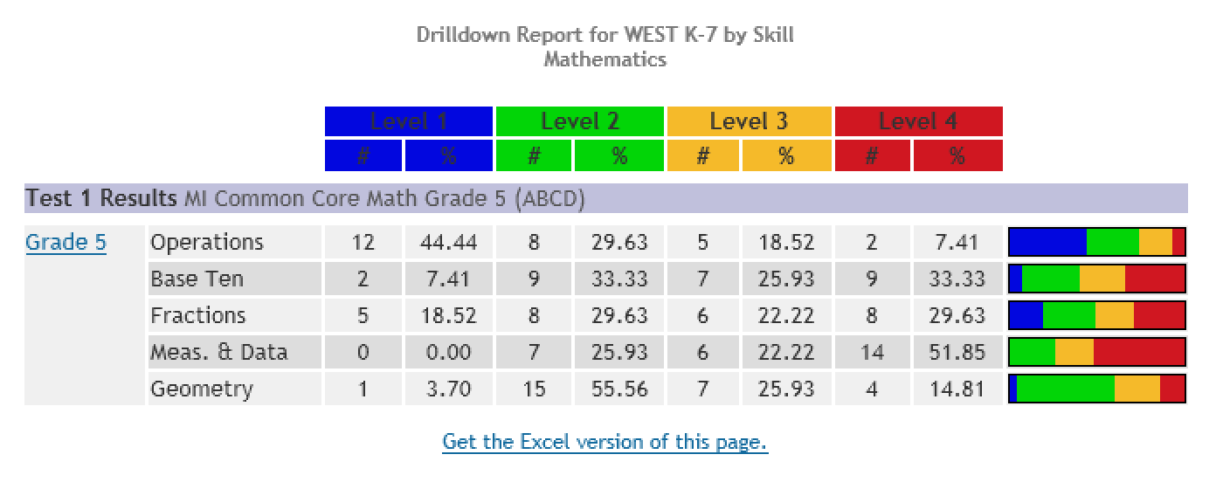
Drill Down
Provides you with colored keys and quick visuals
Click blue hot links for more information.

Slide 7
Remember to click the blue to go “drill” deeper!
Visual color blocks enables you to quickly see student performance level.
Report Menu

Slide 8
Interactive Item Summary
This is where you select the assessment that you want to view the data for. You only need to toggle the CLASS and TEST windows. The skillset will automatically switch to Common Core

Slide 9
Clicking on any part of the red bar will reorder data accordingly
Tells you the question # & correct answer. Clicking on the question # will give you the test question.
Clicking on the + button allows you to see your students listed in the right or wrong column with their names in the column of the answer they chose.
Provides you with common core category and subcategory. Clicking on these will provide you with further detail about either the category or subcategory.

Slide 10
Wow! Resources

Slide 11
Embedded Resources!
Worksheet
Movie
Report Menu

Slide 12
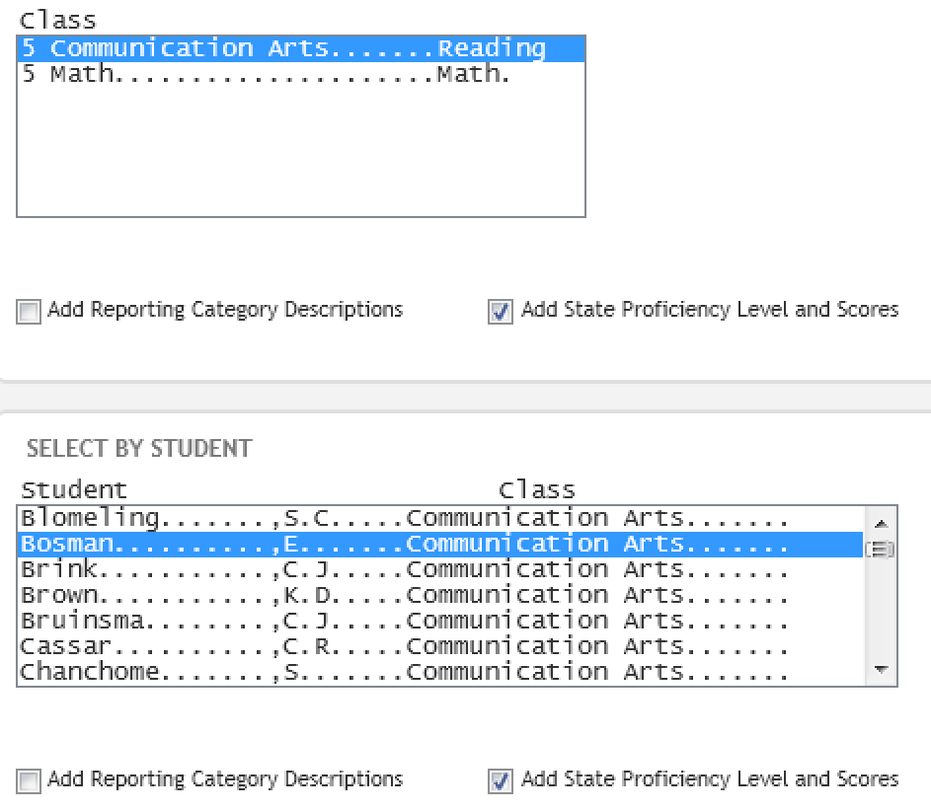
PDF Individual Student
Section for looking at class set of individual reports
Section for single student report

Slide 13
Report Menu

Slide 14
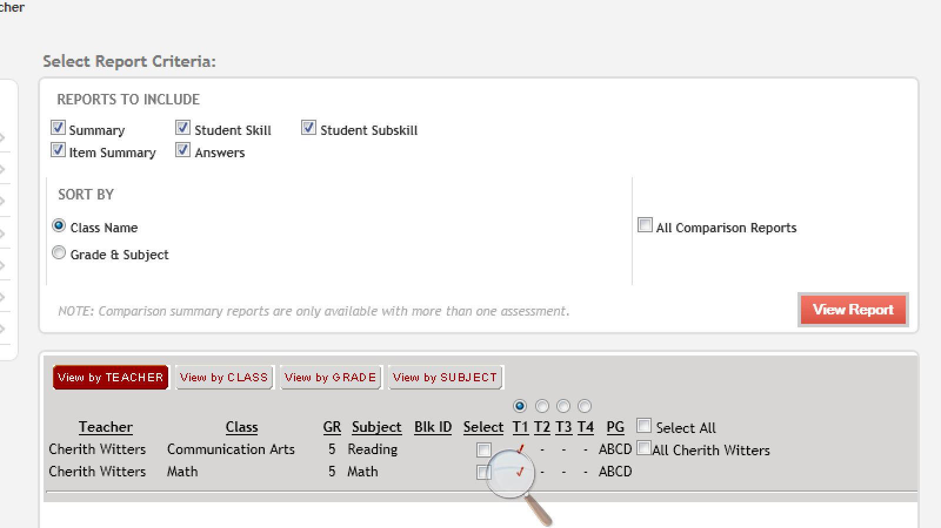
PDF Teacher
Click here after choosing information
Select desired information. You can check both if you like.
Report Menu

Slide 15
Guide to Specific Reports
Now choose a report to view by clicking on it!
Drill Down
Interactive Item Summary
PDF Individual Student
PDF Teacher
FINISHED

Slide 16
To view this slide show again click the “start over” button. If you are finished, press “esc.” If you have any further questions, please see: Joy Klawiter Vicki Shearer Cherith Witters
Start Over

